Slide 1
SHOPPING MALL SALES REPORT
By SAI PRASANTH

Slide 2
AGENDA
Introduction
Problem Statement
Data Exploration
Insight Summary
Recommendation

Slide 3
INTRODUCTION
Unlocking Insights into Istanbul's Shopping Trends
Welcome to the fascinating world of Istanbul's shopping habits! In this data analysis project, we delve into a rich dataset spanning the years 2021 to 2023, encompassing the shopping experiences of diverse age groups and genders across 10 different shopping malls in this vibrant city.
Istanbul, a city renowned for its unique blend of history and modernity, offers a captivating glimpse into the dynamics of consumer behavior. Our dataset, meticulously curated, includes crucial information such as invoice numbers, customer IDs, age, gender, payment methods, product categories, quantity, price, order dates, and shopping mall locations.

Slide 4
PROBLEM STATEMENT
Investigate and Analyze Sales Trends and Patterns in Istanbul's Shopping Malls from 2021 to 2023.
The aim of this data analysis project is to gain a comprehensive understanding of the sales trends and patterns within the shopping malls of Istanbul over a period spanning from 2021 to 2023. We seek to answer critical questions related to consumer behavior, purchase habits, and the factors influencing sales performance in this dynamic retail environment.
Identify and analyze temporal sales trends over the three-year period to understand the growth or fluctuations in sales volumes.
Investigate how different product categories contribute to overall sales and identify any category-specific trends.
Examine whether there are distinct shopping patterns based on customer age, gender, and payment methods.

Slide 5
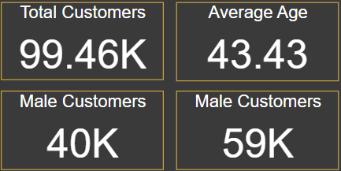
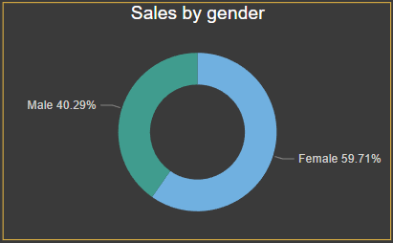
DATA EXPLORATION
Customer Details
The data illustrates a total customer count of 99.46 thousand individuals who engaged in shopping activities over the three-year period. Amongst this cohort, male customers numbered 40 thousand, while female customers comprised the majority, totaling 59 thousand.
Average age of customers is 43.4 .
The sales analysis reveals that male contributions account for 40.29% of total sales, while female contributions dominate at 59.71%, signifying a notable predominance of female customers in driving sales.

Slide 6
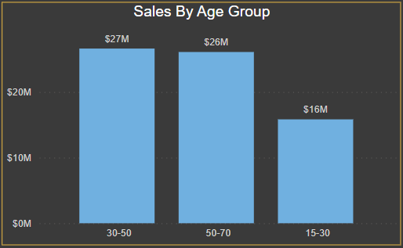
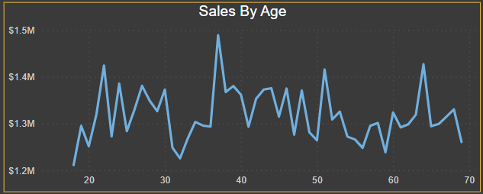
DATA EXPLORATION
Sales By Age
The data depicted in the figure reveals that the highest sales figures, amounting to $27 million, are observed within the age group of 30-50. Following closely, the age group of 50-70 contributes significantly with sales totaling $26 million, while the 15-30 age bracket lags behind with sales amounting to $16 million.

Slide 7
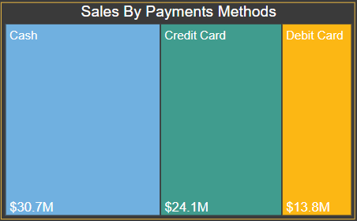
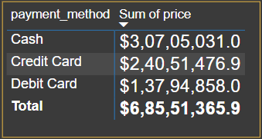
DATA EXPLORATION
Sales Based On Payment Method
Based on the provided data, it is evident that the predominant payment method utilized by customers is cash exchange, accounting for a total revenue of $30.7 million. Following closely, credit card transactions contributed significantly to the revenue, totaling $24.1 million, while debit card users constituted the lowest share with a revenue of $13.8 million.

Slide 8
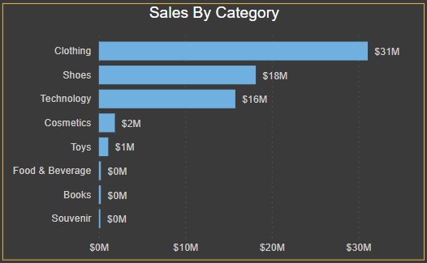
DATA EXPLORATION
Sales Based On Category
Within the spectrum of product categories, it is evident from the data that clothing emerges as the highest revenue-generating category, boasting sales totaling $31 million. Subsequently, shoes follow suit with a substantial revenue of $18 million, while the technology category secures the third position with sales amounting to $16 million.
The amalgamation of these three categories collectively accounts for a significant 95% share of the total sales revenue.

Slide 9
INSIGHT SUMMARY
Data Insights From The Data Set
Female customers are having more contribution on sales as compared to male customers.
The age group of 30-50 are the major contributor of sales($27 million).
Customers are using cash as the payment method($30.7 million).
Clothing is the category where more number of sales have happened($31 million)

Slide 10
RECOMENDATIONS
We need to attract males as the ration of females are higher in sales , in our stores we must add the new and trending designed clothes for men .
As the age group of 15-30 are the least sales generating group , we must add new design clothes and must also provide extra coupons and discounts.
The relatively lower utilization of debit cards by customers warrants a thorough examination of our payment systems to identify any potential technical issues. If such issues are identified, it is imperative that we resolve them promptly to ensure a seamless payment experience for our customers. Should our investigation reveal no technical errors in our payment systems, we should consider implementing incentive strategies, such as additional discounts or cashback offers, to incentivize customers to choose debit cards as their preferred payment method.
Foods and Beverage , Books and Souvenir are the least selling categories , in the first case if we talk about Foods and Beverage , we need to keep our food hygienic and fresh for customer satisfaction and introduce more fast foods which will attract customers. In the second case in the Books category , we have to keep the books of most selling authors and publishers . And in the third case Souvenir category , we have to keep more varieties of Souvenir and must also provide offers and discounts .

Slide 11
THANK YOU

